Slide 1
Faculty of Science
Lund university

Slide 2
A world-class university that works
to understand, explain and improve
our world and the human condition.
Lund University vision

Slide 3
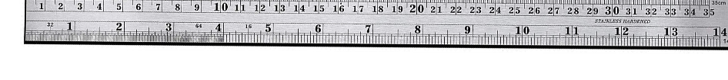
Faculty of Science
8 departments and one centre
Around 1 100 employees
Approx. 3000 students (1 600 full-time equivalents)
Bachelor’s programme with 13 specialisations (3 in English)
The hospital physics programme
Around 30 master’s programmes
Around 20 postgraduate disciplines
More than 80 doctoral degrees and 10 licentiate degrees per year
Notes:
The figures are based on the 2023 financial year.
PhD students are counted as employees, depending on their financing. They are students in all aspects except the financial one, which is important to point out since they bring up the staff number without being ”staff” per se.

Slide 4


Departments at the faculty
Centre for Environmental and Climate Science, CEC
Centre for Mathematical Sciences
Department of Biology
Department of Chemistry
Department of Geology
Department of Physical Geography and Ecosystem Science
Department of Physics
Division of Medical
Radiation Physics

Slide 5

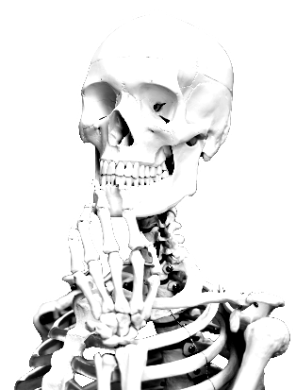
Personnel
Full-time equivalents: 985 (41% female)
Professors: 119 (26% female)
Senior lecturers: 105 (24% female)
Career-development positions: 120 (38% female)
Lecturers: 9 (55% female)
Other lecturers and researchers: 172 (40% female)
PhD students: 265 (45% female)
Administrative staff: 140 (69% female)
Technical staff: 40 (30% female)
Library staff: 15 (60% female)
Notes:
The figures are based on the 2021 financial year. Source: Kuben.
The slide shows the number of full-time equivalents (not individuals) and the percentage who are female.
Professors
Senior Lecturers
Career-development positions – postdocs, associate senior lecturers
Lecturers = teaching staff
Other lecturers and researchers – researchers, research engineers (sometimes they teach as well)
PhD students – all in all they are students, but they are employed and financed by the university, which is why they are included in this slide.
Administrative staff – administration such as staff working with economy, human resources, communication etc.
Technical staff = laboratory assistants, janitors etc.
Library Staff

Slide 6
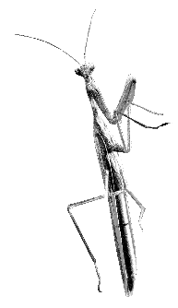
Funding
Total revenue: SEK 1 305 million
Central government allocation, 52%
Government grant providers, 22%
Fees, remuneration and assignments, 9%
Foreign grant providers, 9%
Other Swedish grant providers, 9%
Notes:
The figures are based on the 2021 financial year. Source: Kuben
Central government allocation – funding from the state.
Government grant providers – granted in competition, i.e. Vinnova, Vetenskapsrådet, Formas, etc.
Other Swedish grant providers – non governmental, i.e. Knut och Alice Wallenberg, Stiftelsen för strategisk forskning, Crafoord etc.
Foreign grant providers – granted in competition, i.e European Research Council etc.
Fees, remuneration and assignments – can be different things, for instance conferences, teaching at other universities, research done for other organizations an companies etc.

Slide 7
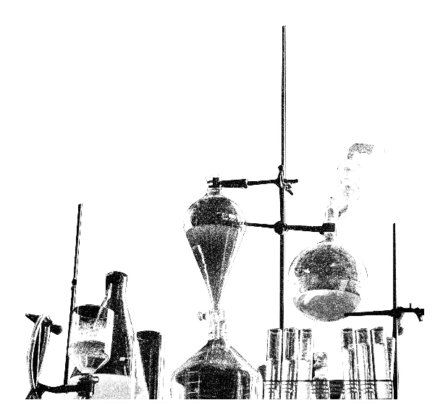
Education
Almost 3000 students in first and second cycle education (1 600 full-time equivalents)
Pre-university course in natural sciences (in Swedish)
Bachelor’s programme with 13 specialisations (3 in English)
The hospital physics programme
Around 30 master’s programmes within our subject areas
Postgraduate studies – 22 postgraduate disciplines
400 students in third cycle education
Notes:
The number of students is including the paying and exchange students, but not commissioned education.
Pre-university course: 1 year
Bachelor’s program: 3 years
Master’s program: 1 or 2 years
Hospital physics program: 5 years
Postgraduate studies: 4 years

Slide 8
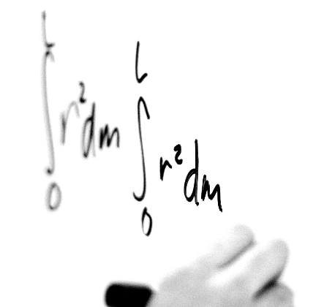
Bachelor’s programmes
Astronomy and Astrophysics
Biology
Chemistry
Chemistry/Molecular Biology
Environmental Health
Environmental Science
Geology
Mathematics (in English)
Molecular Biology
Physical Geography and Ecosystem Science (in English)
Physics (in English)
Theoretical Physics
Notes:
Technically it’s one Bachelor’s programme, with 12 specialisations.

Slide 9
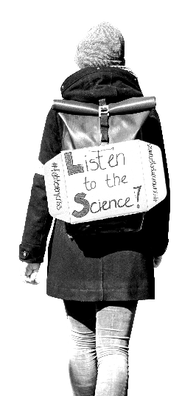

Master’s programmes
Programmes within:
Applied Climate Change Strategies
Applied Computational Science
Astrophysics
Bioinformatics
Biology
Chemistry
Computational Science
Geology
Mathematics
Molecular Biology
Physical Geography and Ecosystem Science
Physics
Notes:
There are specialisations within the programmes.
Master’s programmes = 2 years (with one exception: Environment and Health Science (1 year only))

Slide 10
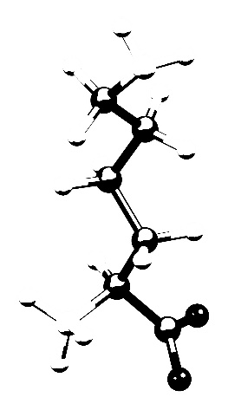
Postgraduatestudies within science
Biology
– Molecular Biophysics
Chemistry
– Analytical Chemistry
– Biochemistry
– Chemical Physics
– Inorganic Chemistry
– Organic Chemistry
– Physical Chemistry
– Theoretical Chemistry
Environmental Science
Physics
– Astronomy and Astrophysics
– Chemical Physics
– Theoretical Physics
– Theoretical Physics, specialization
Computational Biology
Geobiosphere Science
with specialization in:
– Geographical Information Science
– Lithosphere and Palaeobiosphere Sciences
– Physical Geography and Ecosystem Science
– Quaternary Sciences
Mathematics
– Mathematical Statistics
– Molecular Biophysics
– Numerical Analysis
Medical Radiation Physics

Slide 11

Research
Climate change
Animal super senses and development of life on earth
Future materials and effective medicines
Origins of the Milky Way and nature’s smallest components
New opportunities with MAX IV and
European Spallation Source (ESS)
Notes:
Climate change
State-of-the-art climate change research is also carried out at our faculty. Researchers from various disciplines work from different perspectives to produce models and scenarios of how the climate could change. They also study how we can best adapt to, and mitigate, climate change.
Animal super senses and the development of life on earth
A number of our research groups in biology study fascinating super senses of everything from dung beetles to seabirds. The knowledge provides clues to animals’ behaviour and could lead to new inventions. Our researchers also study the development of life on earth. Objects of study include the appearances of animals and plants that lived millions of years ago and dramatic events that influenced their lives.
Future materials and effective medicines
A number of our research groups are working to develop the materials of the future. The research leads to more environmentally friendly and efficient solutions to meet the challenges in everyday life and industry. Finding methods to speed up diagnosis and to develop new effective drugs with fewer side-effects are other ongoing research projects.
Origins of the Milky Way and nature's smallest components
Our astronomy researchers actively participate in, for example, the hunt for the origins of the Milky Way. At the faculty we also study nature’s smallest component parts, requiring large accelerators, efficient detectors and clever computer software. A number of our researchers work at the experiment stations at CERN and at several other research facilities in different countries. In Lund we also have major research facilities. Two upcoming facilities are MAX IV and ESS.
New opportunities with MAX IV and ESS
The MAX IV synchrotron radiation source produces synchrotron radiation of world-leading quality that is used to study many different types of sample. Examples include nanostructures, proteins, solar cells and materials for catalysts. The high quality of the light makes it possible to see more detail and carry out new types of experiment that have not been possible before. There is also be a short pulse facility at MAX IV, where short flashes of light can be produced to follow chemical reactions with a very high temporal resolution.
At ESS, it is instead beams of neutrons that will be used to study samples from many different fields, for example plastics, medicines or magnetic materials for data storage. The technology that will be used at ESS will make the facility the best in the world at producing neutrons for research. Since neutrons and synchrotron radiation have different properties, ESS and MAX IV complement each other. It will be possible to study different types of samples, or the same samples in different ways, for example at different scales. The close proximity between MAX IV and ESS is therefore a further advantage.

Slide 12
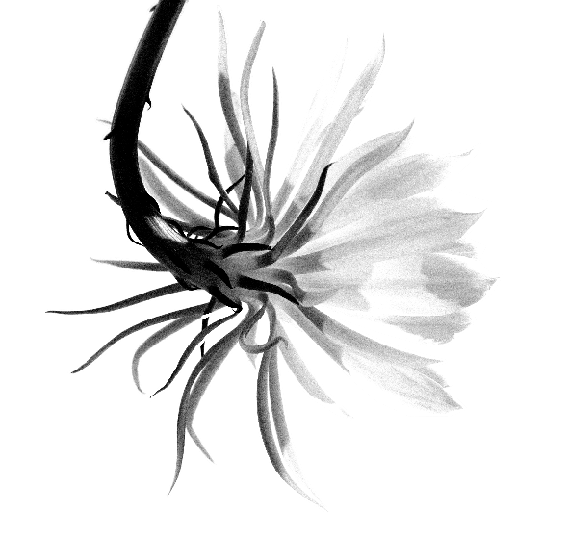
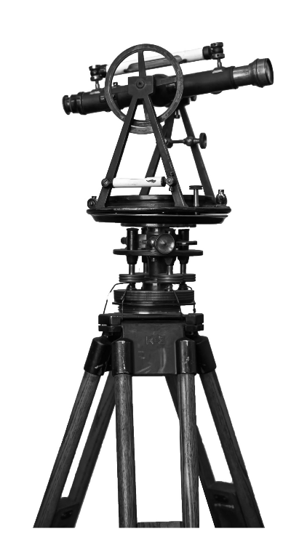
External engagement
NMT days
LUNE days
Culture Night in Lund
School visits
Museum activities
Folkhögskolan Hvilan (folk high school)
Notes:
NMT Days: A collaboration focusing on science, medicine and technology between the Faculty of Science, the Faculty of Medicine and the Faculty of Engineering, LTH. The event offers some 100 popular science lectures to around 6 000 upper secondary school pupils and their teachers during a week in March.
LUNE Days: For primary and lower-secondary school pupils and their teachers. One week in May for grades 6-7 and one week in August for grades 8-9. The classes have a day in which they can watch chemistry shows, biology shows and physics and laser shows. They get a guided tour of the campus and see the study environments.
Culture Night in Lund: The Faculty of Science offers a science festival for the whole family. Visitors can watch shows, carry out experiments, listen to popular science lectures etc. Culture Night is an annual event held on a Saturday in September.
Media: Popularisation of research through channels such as press releases, involvement in radio, tv, newspapers, books etc.
School visits: We accept visits from individual pupils who want to do an internship, shadow a student for a day and suchlike. We also visit schools (student ambassadors who talk about courses and programmes as well as individual researchers who participate in various contexts).
Museum activities: Biological Museum.
Folkhögskolan Hvilan: In this collaboration with a folk high school, we offer a type of science foundation year, which qualifies the pupils for our courses and programmes. The aim is to broaden our recruitment.

Slide 13
End slide, logotype only

